Slide 1
Analyzing and Predicting Stock Market Prices
Nandini poddar (UIN : 652404994)
Vatsal shah (UIN : 653763850)
AnuraAg Banerjee (UIN : 677398706)

Slide 2
DATASET
Variable | Description
Date | This captures all the Opening, Closing, High and Low Stock Prices that are captured in a day.
Open | Open is the price of the stock at the beginning of the trading day (it need not be the closing price of the previous trading day).
High | High is the highest price of the stock on that trading day.
Low | Low the lowest price of the stock on that trading day.
Close | Close the price of the stock at closing time.
Adj_Close | Adjusted close is the closing price of the stock that adjusts the price of the stock for corporate actions.
Volume | Volume indicates how many stocks were traded.

Slide 3

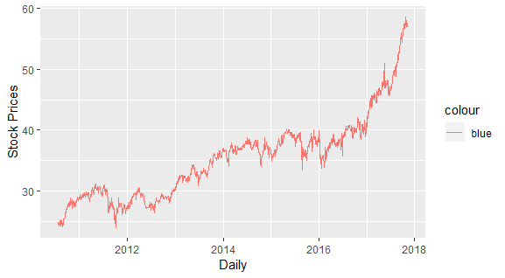
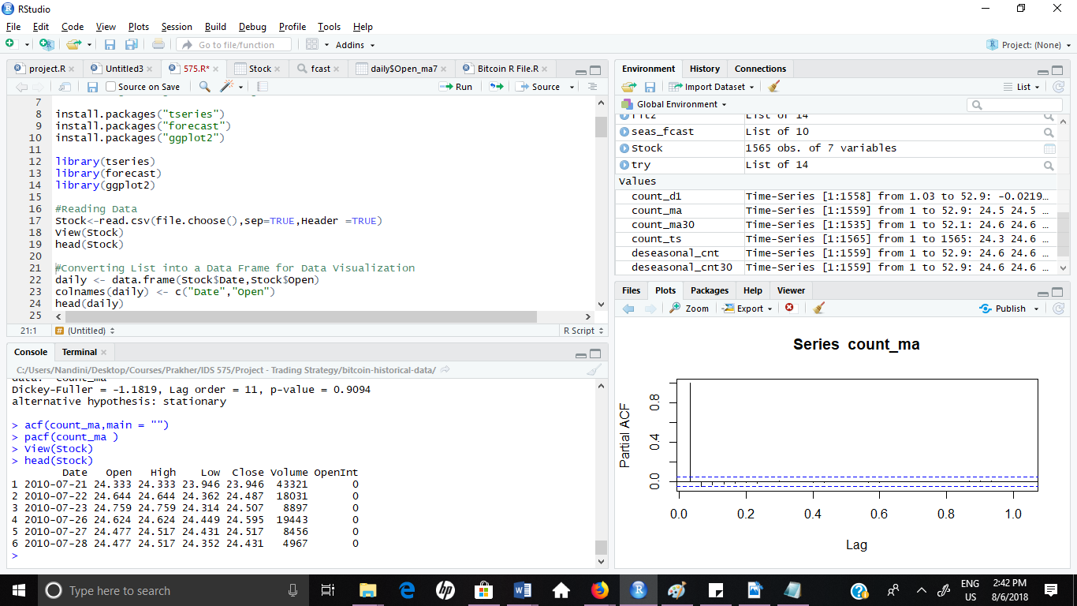
PLOTTING TIME SERIES DATA

Slide 4
MOVING AVERAGES
Visually we could draw a line through our data i.e. the line would contain average points across several time periods, called the Moving Averages thereby smoothing the observed data into a more stable predictable series.
The moving average is extremely useful for forecasting long-term trends.
We, then calculated the Weekly and Monthly Moving Averages.

Slide 5
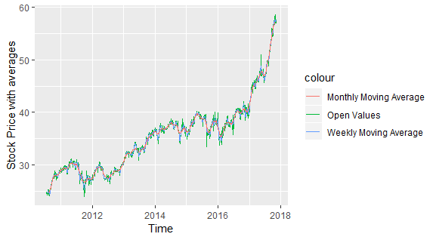
PLOTTING WEEKLY, MONTHLY AND DAILY OPEN PRICES

Slide 6
DECOMPOSING TIME SERIES
Decomposing a time series means separating it into its constituent components:
1. The trend (long term direction)
2. The seasonal (systematic, calendar related movements)
3. The irregular (unsystematic, short term fluctuations)

Slide 7
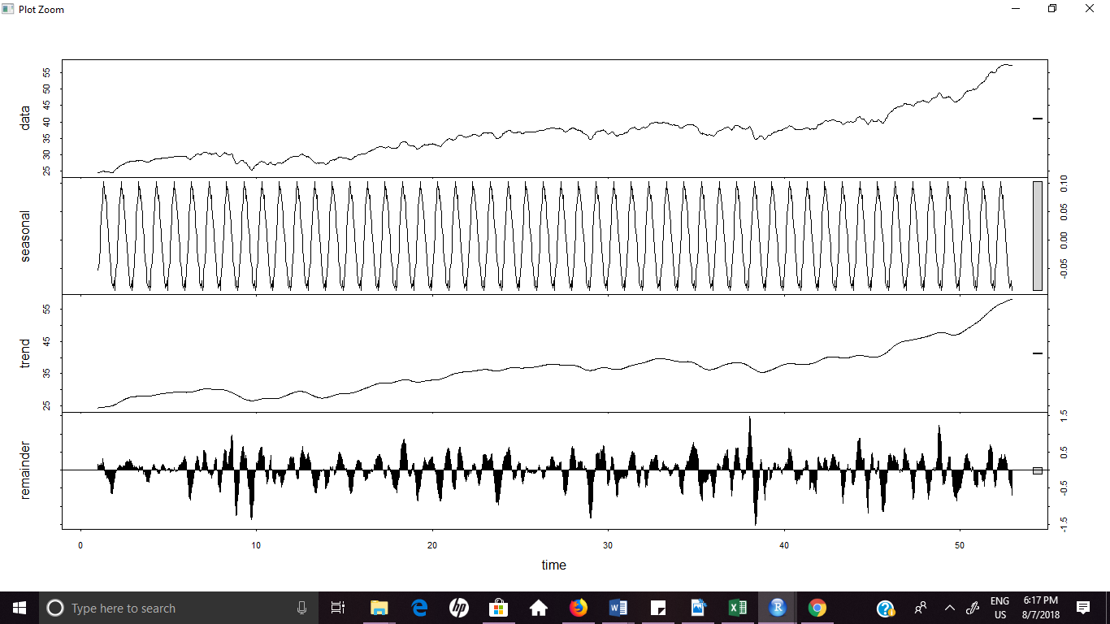
We decomposed our data using stl()

Slide 8

ADF Test
As the p value is huge we saw the weekly moving average was not stationary.
So, checked the stationarity of differences of weekly moving averages.ull hypothesis, i.e. weekly moving average is not stationary. Hence, we will check for the stationarity for the difference of weekly moving average.

Slide 9
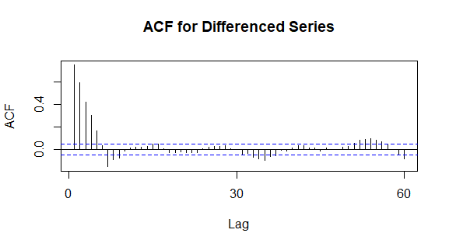



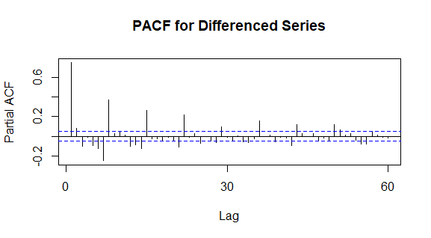

ACF and PACF

Slide 10
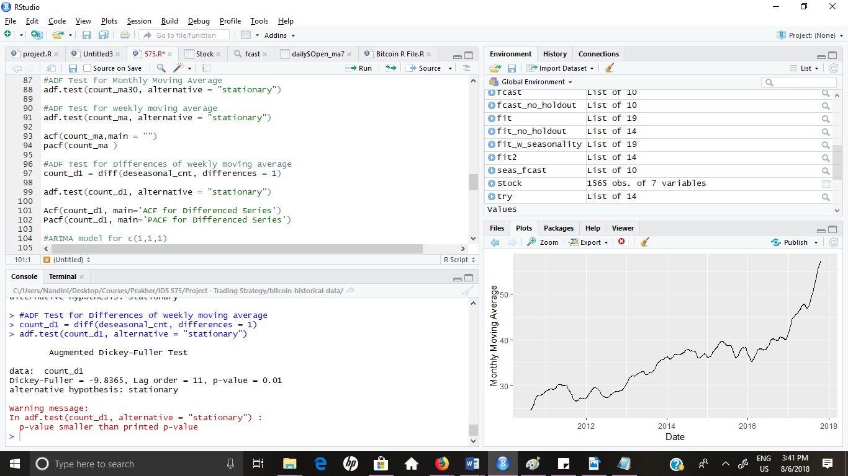
Test Statistics for Difference of Moving Averages
P-value is less than the alpha values,
Therefore, reject the null hypothesis.
The difference of weekly moving average is stationary. Hence, we will go ahead with the difference for building the ARIMA model.

Slide 11
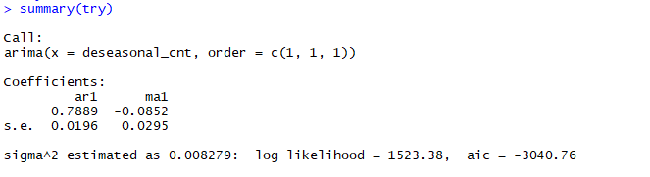
T statistics for ARIMA Model: Lower value of AIC implies the model is close to truth.

Slide 12
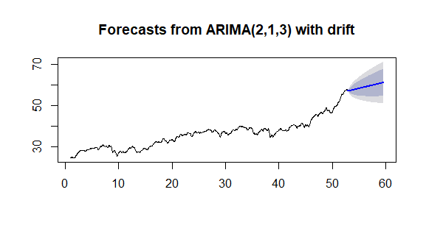
Here is our ARIMA model with future predictive values going through the next 250 points. We can keep increasing the prediction values which will give us an estimate of the prices.

Slide 13
Conclusion:
If the sign of the forecasted return equals the sign of the actual returns we have assigned it a positive accuracy score.
The accuracy percentage of the model comes to around 68%.
We can try running the model for other possible combinations of (p,d,q) or instead use the auto.arima function which selects the best optimal parameters to run the model.

Slide 14
THANK YOU! ☺

